Slide 1

PRESENTED BY Team TGIBF
Brad Kim, Casey O’Malley, Qi Ding, Caffrey Lee, Zoe Huang

Slide 2

Part 01
Fun Facts
CONTENTS
Part 02
Recommender System
Part 03
Market Basket Analysis

Slide 3


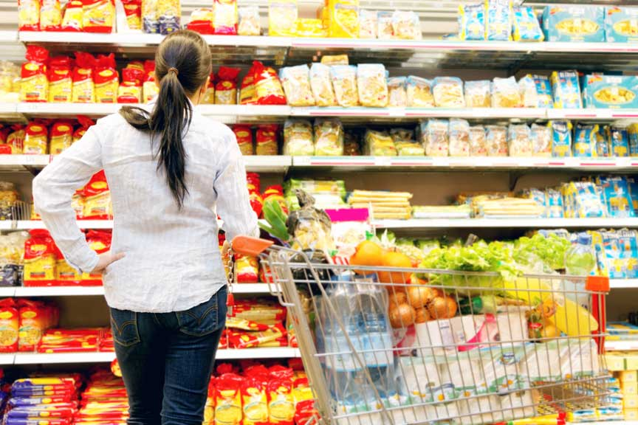

Black Friday Sales
Part 01
Introduction
GOAL:
Black Friday Data
The dataset contains of 537577 observations about Black Friday sales in a retail store. There are 12 different variables, including a mix of numeric and categorical variables.
The store wants to know more about customer purchasing behavior for different products so they can use that knowledge to increase their sales.
Data Source :
https://www.kaggle.com/mehdidag/black-friday
Increase Sales
Clustering Analysis
Recommender System
Market Basket Analysis

Slide 4
Black Friday Sales
Part 01
Fun Facts
Fun Fact 1: The number of female customers and their average purchase amounts are less than those of male customers
# of Customers by Gender
Average $ spending by Gender
1666
4225
8890$
9504$
Female
Male
Female
Male
Notes:
By exploring data, the first thing we found interesting is that both the number of female shoppers and their average spending are actually less than those of males. Probably these products are male-oriented or less number of females paid for the products and maybe their husbands paid for them.

Slide 5
Black Friday Sales
Part 01
Fun Facts
Fun Fact 2: Which customer age groups have the most interest in the brand?
Average purchase amount by age per person($)
970K
840K
860K
780K
750K
600K
530K
0-17
18-25
26-35
36-45
46-50
51-55
55+
Notes:
Secondly, people aging between 26-35 tend to buy more products and spend more money. Usually in that age, people's financial status is better than younger people. while they are more interested in technology and promotions more than older people.

Slide 6




Black Friday Sales
Part 01
Fun Facts
Fun Fact 3: Purchasing power is not directly related to the amount of purchases for each customer
Number of Customer
Amount of Transaction
Average Transaction
1045
1707
3139
145k
226K
166K
8.9K
9.2K
9.8K
A
B
C
A
B
C
A
B
C
Notes:
Thirdly, one inference we can make from these charts is that the higher number of customers do not necessarily bring about a higher sales

Slide 7
Black Friday Sales
Part 01
Fun Facts
Fun Fact 4: People living in the current city for one year spend the most at the store
Number of Years Customers Living in the Current City
772
2086
1145
979
909
0
1
2
3
4+
Notes:
Fourthly, people who live for a year consume the most, and then decrement, which makes sense in real life. When you first come to the city, you need to buy all kinds of daily necessities

Slide 8
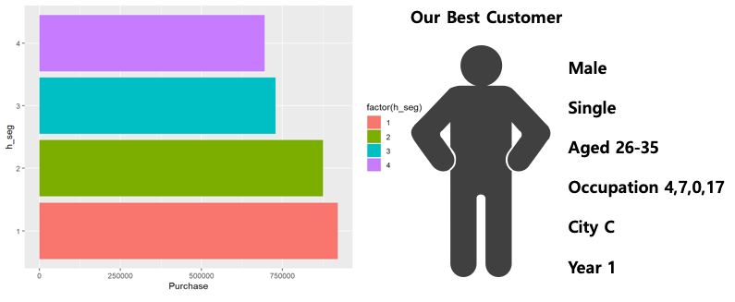
Black Friday Sales
Part 01
Fun Facts
Fun Fact 5: Based on k-means analysis result, our best customer is… (dun dun dun)
Male
Single
Aged 26-35
Occupation 4,7,0,17
City B
For one year
Notes:
We did kmeans analysis based on needs-based variables, and also demographics. We found that our best customer is a single male aged between 26 and 35, stayed in city B for only one year. With these info we target our customer to increase sales. Now, Brad will walk you through our recommender system analysis.

Slide 9
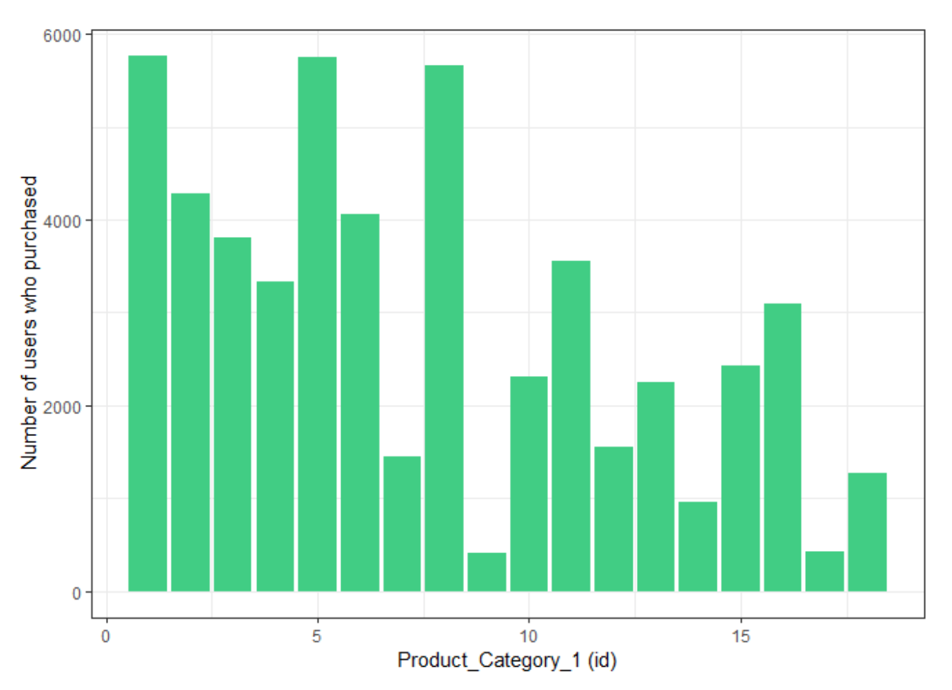
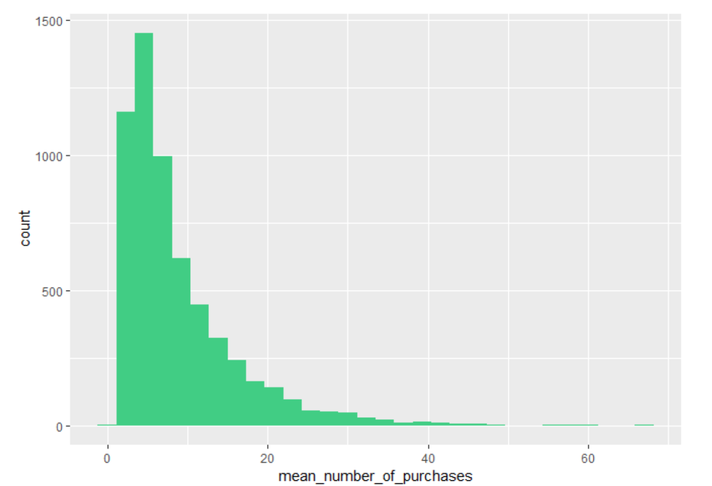

Black Friday Sales
Part 02
Recommender System
5891 users and 3623 products (sparsity of User-Product matrix ~ 2%)
Instead of products, product categories are analyzed, since products are divided into only 18 categories (Product_Category_1)
Analysis Assumption: 1 purchase = 1 rating
The most purchased products are in product category # 1, 5, and 8.
The average number of purchases for each user is different (income, budget, etc.)
cf) User-Product Category matrix:
Notes:
There are over 5000 users and 3000 products in our dataset. Because of the sparsity issue, we decided to analyze the 18 product categories rather than thousands of products. Also, in this analysis, we assumed that 1 purchase means 1 rating. At the bottom, we see how the user-product category matrix looks. From this matrix, we see in the left figure that the most purchased products are in product categories #1, 5, and 8. We can also see that the average number of purchases for each user is different due to their income or spending plan.

Slide 10
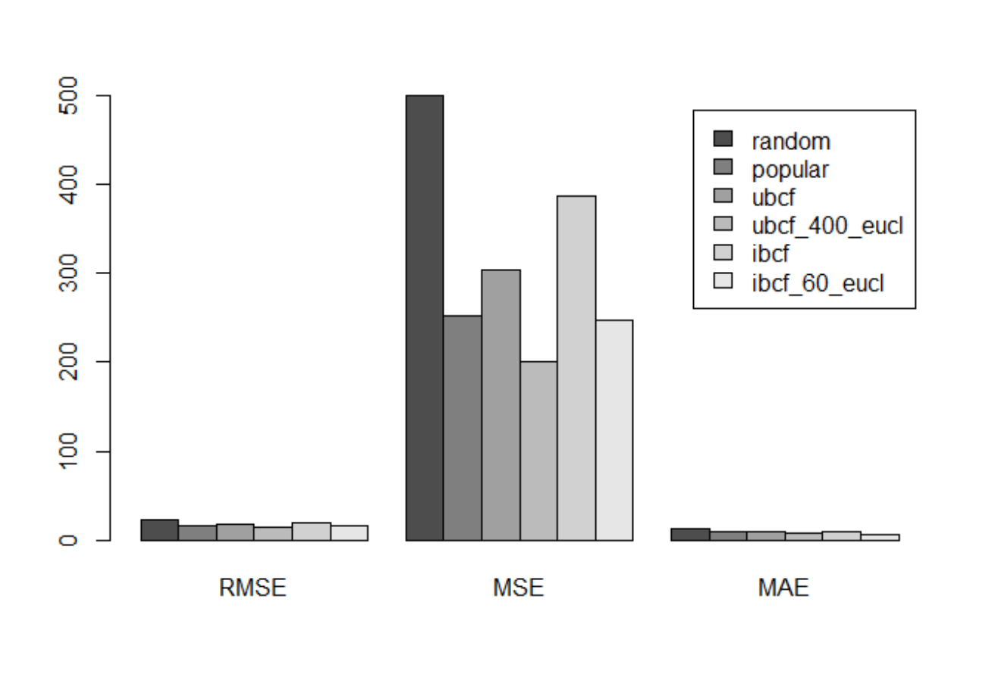
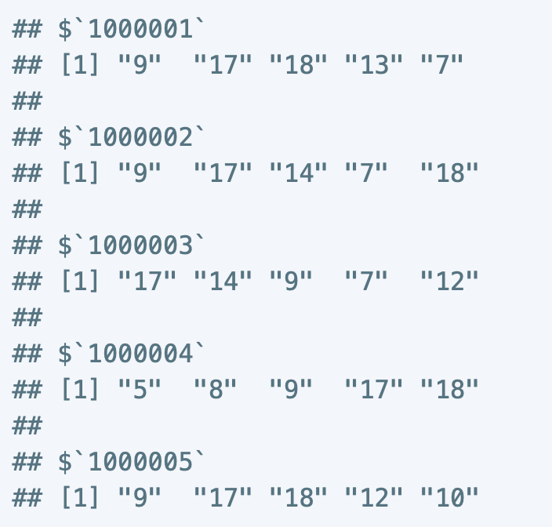
Black Friday Sales
Part 02
Recommender System
UBCF with optimized parameter sets shows the lowest RMSE (~ 14.0).
Through this model, each user is given top 5 recommendations among their unpurchased products.
22.3
19.5
17.3
15.7
14.0
19.5
Notes:
We tested different models for our recommender system: random, popular, ubcf, ibcf. We found that UBCF with optimized parameters sets showed the lowest RMSE. And using this model, we are able to customize product recommendations for each user. The right picture shows top 5 recommendations for the first 5 users. Now, Casey will walk you through the market basket analysis.

Slide 11
Black Friday Sales
Part 03
Market Basket Analysis
The market basket analysis is highly relevant to this store
This will allow the store to better understand which products pair best with each other and could reveal potential opportunities for promotions
The three iterations of our analysis are shown below:
Support | Confidence | # Rules
0.05 | 0.05 | 3280
0.2 | 0.05 | 25
0.01 | 0.75 | 5
The first attempt included the same parameters as our first attempt in class. It yielded far too many rules for interpretation.
The second attempt yielded a reasonable amount of rules, but we found that there was no product associations occurring in any of the rules. Rules without lhs values do not help us achieve insights.
The third attempt yielded five rules that all showed associations between different products in the dataset. This can lead to actionable insights for the store.
Notes:
The market basket analysis is very relevant to this store because they want to be able to understand which products pair best with other products and use that information to create promotional events.
We did 3 iterations of a market basket analysis:
In the first attempt, we set the support and confidence parameters very low. This yielded too many results for interpretation.
In the second attempt, we increased the support parameter. This cut it down to 25 rules, but the rules that were generated didn’t show us any associations between products (lift = 1 for every rule).
In the third attempt, we lowered the support parameter back down and increased the confidence parameter. This yielded 5 association rules that showed actionable insights for the company.

Slide 12
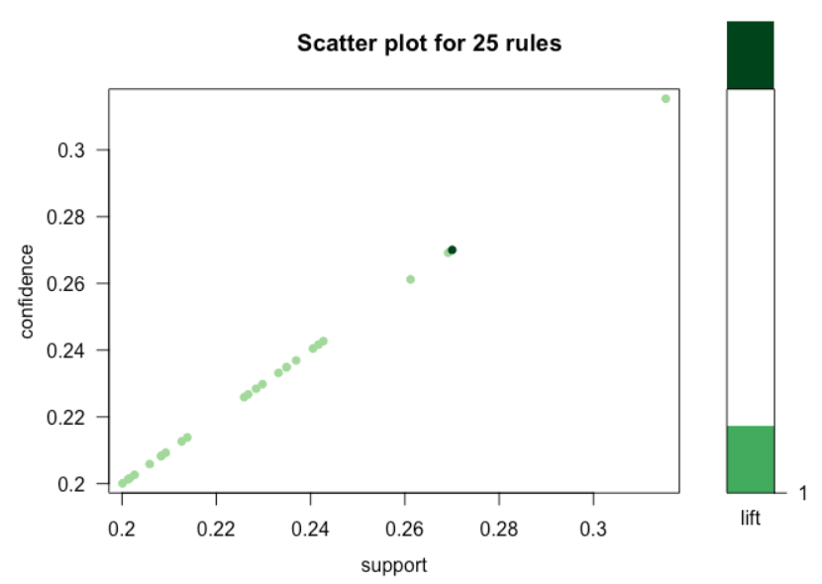
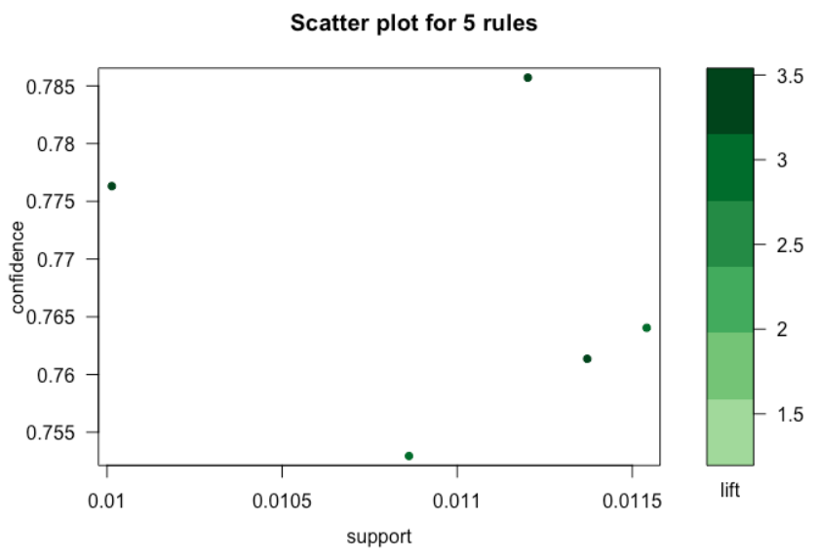
Black Friday Sales
Part 03
Market Basket Analysis
The visualizations below will better explain how we interpreted the support, confidence, and lift for the association rules from our second and third attempts:
Second Attempt:
Third Attempt:
Notes:
These plots show the relationship between support and confidence in our association rules. The perfectly direct relationship shown on the left was a red flag since it means the support and confidence are the same for each rule and only one product is being observed. The plot on the left is randomly distributed, which shows us that the system actually found association rules with more than one product.

Slide 13
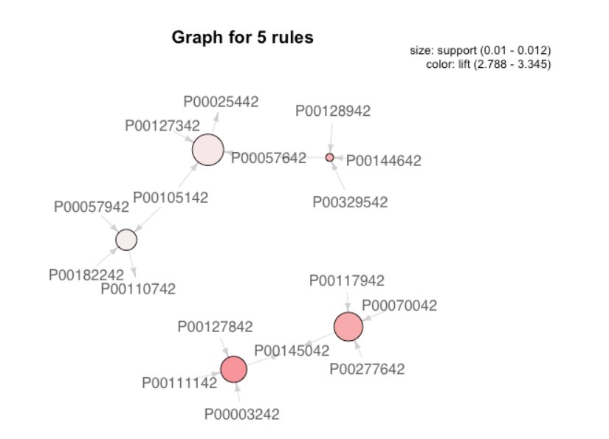
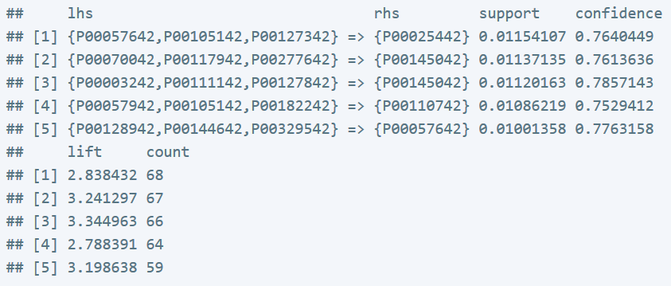
Black Friday Sales
Part 03
Market Basket Analysis
The visualization below will better explain the association rules generated by our third attempt:
Notes:
The visualization and table in this slide show our final set of rules. The circle sizes are based on their support values, and their colors are based on their lift values. This was a successful rules set, but we can’t do much with this data if we don’t have the underlying product information. For now, our analysis is finished. Does anyone have any questions?

Slide 14


Black Friday Sales
Part 03
Market Basket Analysis
{P00057642,P00105142,P00123432}
=>
{P00174442}
Support 0.0115
Confidence 0.0113
Lift 2.8384

Slide 15
Black Friday Sales
Part 03
Market Basket Analysis
Thank you

